Slide 1



CS F429 | Natural Language Processing
Reinforcement Learning–Based Dynamic Ensembling of Small LLMs
Paper - Hu,J.etal. (2024). Dynamic ensemble reasoning for LLM experts. arXiv:2412.07448v2
End-sem Presentation
Gadamsetty Lakshmi Monish | 2023A7PS0602P
Amruth Srivatsan | 2023A7PS0026P
Samarth Agrawal | 2023A8PS0716P
Dosi Rushil | 2023A7PS0023P

Slide 2

Introduction
Large Language Models (LLMs) have different strengths based on their design, size, and training data. As a result, a single model often does not perform well on various tasks. Current ensemble methods either need to run many large models for each query, which is costly, or rely on fixed rules that do not take advantage of the combined knowledge from different models. This project modifies the Dynamic Ensemble Reasoning (DER) concept for small, student-friendly LLMs. We aim to create a reinforcement learning (RL) agent that redirects a query among a small group of models to produce high-quality results at a low inference cost.
We propose a Dynamic Ensemble Reasoning framework based on reinforcement learning that treats ensembling as a sequential decision problem. This is formulated as a Markov Decision Process (MDP). At each step, the RL agent picks one small LLM to query or decides to STOP. It then adds that model’s output to the context. A learned policy improves a reward that balances answer quality with model-call cost. This encourages short but effective reasoning paths that leverage the strengths of different models.
BITS Pilani, Pilani Campus

Slide 3
Ensemble learning
Existing LLM ensemble approaches fall into distinct categories, each with unique strengths and limitations:
Mixture-of-Experts (MoE) Uses a router network to select and activate a subset of expert models. Aggregates diverse expertise but requires retraining and cannot combine non-homologous LLMs or exploit complementary knowledge
Parameter Merging Merges parameters of multiple homologous LLMs into a single unified model. Methods like Fisher Merging and DARE work only for models with same initialization and structure
Rule-Based Methods Combines LLMs through manually designed roles or fixed sequences. Simple to implement but static setup provides poor generalization to new domains or tasks
Agent-Based Methods Trains an agent to dynamically select LLMs based on input. Can integrate non-homologous models but doesn't fully utilize complementary knowledge between experts
BITS Pilani, Pilani Campus

Slide 4
MDP
1. States: The state is defined as a question-answer pair: [Q: input, A: previous answer]. This pair describes the current environment and tracks the quality of the answers generated so far.
2. Actions: An action corresponds to the specific choice of a LLM expert. The agent decides which expert from the available model pool should be activated next to improve the answer.
3. Transitions: The transition is the function that maps a state into a new state. This occurs when the selected LLM generates a new answer using the Knowledge Transfer Prompt (KTP), creating a new state that ideally contains an improved response.
4. Rewards: The reward function serves as the evaluation mechanism. In this task, the reward evaluates the quality of the answer y produced by the selected LLM
BITS Pilani, Pilani Campus

Slide 5
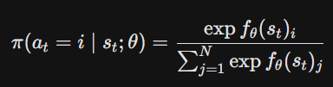
MDP
5. Policy: The policy is the neural network that guides the decision-making. It provides a probability distribution over the possible LLM actions based on the current state. The mathematical formula for choosing action i at time t is given by:
This formula calculates the probability of selecting a specific expert relative to all other available experts (N).
BITS Pilani, Pilani Campus

Slide 6
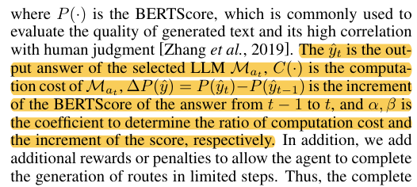
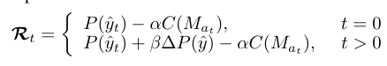
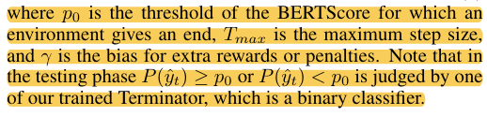
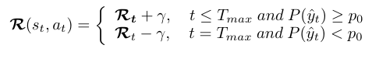
Reward Function
The reward function is crucial for guiding the DER agent, balancing 3 things: the quality of generated answers, the increment quality of the answer, and the computational resources. It adapts based on the current step in the expert selection process.
BITS Pilani, Pilani Campus

Slide 7
Knowledge Transfer Prompt
The Knowledge Transfer Prompt (KTP) uses a role-playing approach to help models improve previous answers instead of starting over. By presenting the earlier output with the phrase "There is an answer to the question from another student... give a more satisfactory answer," the system treats the previous text as a draft. This wording allows the new model to view the prior answer as "additional advice," effectively connecting a chain of reasoning among various experts without repeating role-play text.
BITS Pilani, Pilani Campus

Slide 8
DER Algorithm
The Dynamic Ensemble Reasoning (DER) algorithm starts with the Initialization phase, where the agent receives an input question. At this point, the "state" consists only of the question itself. There are no prior answers present. The process then progresses to the Select LLM phase, where the DER-Agent acts as a policy network within a Markov Decision Process framework. By examining the current state, which includes both the original question and the history of previous answers, the agent selects a specific Large Language Model from the available options. This selection is not random; the agent predicts which model is most likely to improve the current answer based on the context of the query.
After a model is chosen, the algorithm moves on to the Knowledge Transfer phase using a specific prompt structure. Instead of treating the new model as independent, the system provides it with the output from the previous step through a "Knowledge Transfer Prompt" (KTP). This prompt directs the selected model to review the previous answer and use it as a reference to create a better response. This process updates the state of the system, creating a chain where each subsequent model seeks to correct or improve the output of the one before it without starting over.
BITS Pilani, Pilani Campus

Slide 9
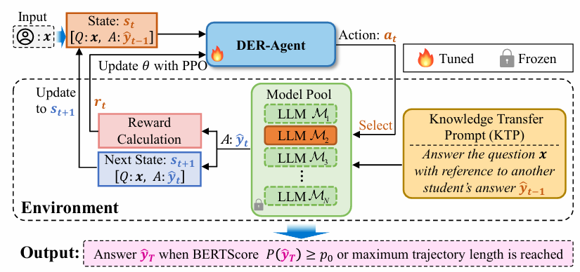
DER Algorithm
The cycle ends with the Evaluate and Terminate phase, where the system decides whether to stop or keep going. After each step, a reward function calculates a score that weighs the improvement in answer quality against the computational cost of using that specific model. The process continues until a certain condition is met: either the answer quality score goes above a set success threshold (Po), indicating a satisfactory solution, or the maximum number of allowed steps (Tmax) is reached.
BITS Pilani, Pilani Campus

Slide 10
LLM models
Choosing the best compact Large Language Model (LLM) depends on your specific needs, especially concerning computational resources and task requirements. We will look at three popular instruction-tuned LLMs. We will highlight their unique strengths and the best use cases for developers and ML practitioners in low-resource or technical settings.
LLaMA 3.2: 3b-instruct-q4_K_M
Model: LLaMA 3.2 by Meta
Size: 3 billion parameters (compact)
Optimisation: Instruction-tuned (chat-ready)
Compression: 4-bit quantisation (q4_K_M) for efficiency
Best For: Good reasoning on low-resource machines.
Qwen 2.5: 3b-instruct-q4_0
Model: Qwen 2.5 by Alibaba
Size: 3 billion parameters (fast)
Optimisation: Instruction-tuned (chat-optimised)
Compression: Basic 4-bit quantisation (q4_0)
Best For: Coding, mathematics, and complex technical tasks.
Mistral: Instruct
Model: Mistral AI (more powerful)
Size: Approximately 7 billion parameters
Optimisation: Instruction-tuned for conversations and tasks
Best For: Superior quality and performance when more memory is available.
BITS Pilani, Pilani Campus

Slide 11
Datasets
BoolQ Dataset
The first dataset used is BoolQ, a question-answering benchmark from the SuperGLUE suite. We chose it as our initial validation testbed because of its binary nature. It consists of triplets (passage, question, answer) where the answer is either "True" or "False." A key feature of BoolQ is its clear evaluation metric: Exact Match Accuracy. Since the output space is limited to two tokens ("yes" or "no"), it offers a simple environment to check the mechanical stability of the RL router before we add more complex text generation tasks.
HotpotQA Dataset
To assess the system's reasoning abilities in more complex situations, we used the HotpotQA dataset. This dataset is unique because it requires multi-hop reasoning. The model must gather information from several supporting paragraphs to create one answer. Unlike BoolQ, the answers here are generated as free-text phrases. This setup tests the router's ability to identify incomplete answers and initiate sequential refinement steps through the Knowledge Transfer Prompt when a single expert cannot gather all necessary reasoning "hops."
BITS Pilani, Pilani Campus

Slide 12
Ensembling methods
1. Static Round-Robin (The Baseline): This is a fixed, rule-based strategy that serves as your control group. Instead of making smart decisions, the system just rotates through the available experts in a set order (e.g., Llama->Qwen->Mistral) for every question. This method assumes that simply having a variety of options is enough to solve problems. It acts as an important baseline because if your AI agent cannot perform better than this basic rotation, it shows that the agent hasn't developed a meaningful strategy yet.
2. Self-Correction (Single Expert Refinement): This method tests the idea of "depth over breadth." Instead of moving between different experts, the system focuses on one strong model (e.g., mistral:instruct) and asks it to improve its answer repeatedly. The reasoning is that a capable model may need a second chance to correct its own errors. In your experiments, this method performed surprisingly well at 88.3%. This suggests that for many questions, giving a good model more time to think is nearly as effective as consulting a team of experts.
BITS Pilani, Pilani Campus

Slide 13
Ensembling methods
3. Dynamic Ensemble Reasoning (The RL Agent):
Unlike other two methods, this method models the routing problem as a Markov Decision Process (MDP). A trained PPO agent acts as a manager.
At each step, the agent looks at the question and the previous answer (the state) and decides which specific expert is best suited to fix the current error.
Unlike Round-Robin, it tries to be adaptive, sending math questions to math models and logic questions to logic models.
It is trained with a reward function that penalizes high costs, forcing it to balance "getting the right answer" with "being efficient".
BITS Pilani, Pilani Campus

Slide 14
Results
Dataset
Ensembling
Method
Accuracy
Avg Calls
Avg Cost
BoolQ (Yes/No)
Round-Robin
89.6%
1.46
9.90
Self- Correction
88.3%
1.25
1.19
DER (Agent)
85.6%
1.44
11.3
HotpotQA
Round-Robin
Self- Correction
DER (Agent)
BITS Pilani, Pilani Campus

Slide 15
Conclusion
DER represents a paradigm shift in how multiple LLM experts can be efficiently combined. By modelling ensemble reasoning as a Markov Decision Process with intelligent knowledge transfer, we achieve nearly 7-fold parameter reduction compared to existing methods while improving performance across diverse tasks.
Dynamic Adaptation:
Routes are selected based on input questions, enabling flexible optimization for different task types and complexities
Complementary Knowledge:
Knowledge Sequential knowledge transfer allows LLMs to build on each other's strengths, creating synergistic improvements
Practical Efficiency:
Achieves superior results with only 15% of inference parameters compared to ensemble methods using all LLM outputs
BITS Pilani, Pilani Campus

Slide 16
Thank you!
BITS Pilani, Pilani Campus

